Slide 1
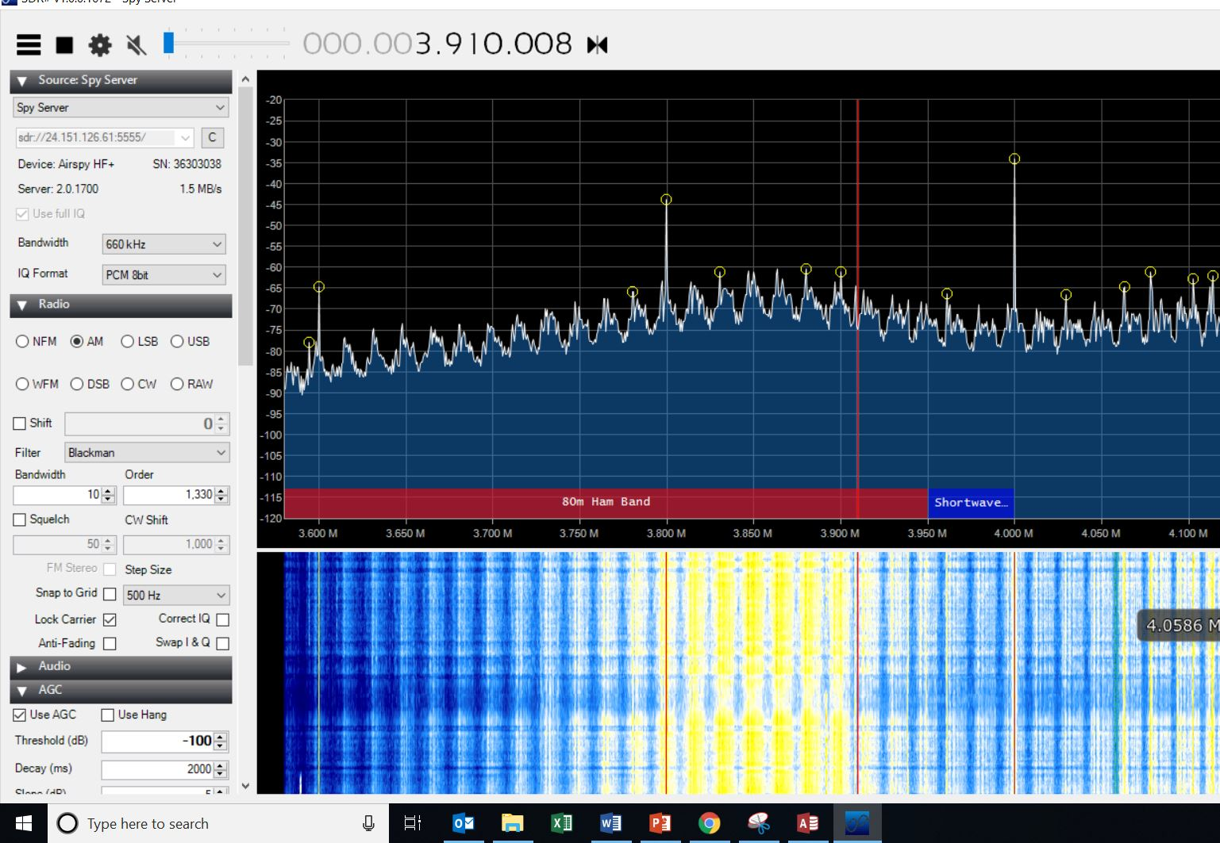
SolarEdge retrofit @ W1VLF Solar Array

Slide 2
SolarEdge retrofit W1VLF Solar Array
The 75 Meter band as seen @W1VLF The antenna is a 160 Meter dipole fed with open wire feed. Screen capture was taken at 12 Noon. Note the strong carriers at 200 KHz intervals. Also note the digital noise “haystacks” at approx. 18 KHz intervals

Slide 3
SolarEdge retrofit @ W1VLF Solar Array
Sources of noise explanation
The “Optimizer” is the source of the 200 KHz peaks. There is 1 optimizer per panel in the 27 Panel 6.25 KWhr solar array. The purpose of the optimizer is 2 fold. One it act as MPPT (Mean Power Point Transfer) device which constantly monitors the PV panel and loads it appropriately in order to extract maximum power output from the panel, based on light level, temperature, and other factors. It essentially a smart DC to DC converter.
The optimizer also performs the rapid shutdown function. Which is required by the NEC. Basically the DC from the PV panels must cease when either the AC inverter is disconnected, the DC disconnect is engaged. This done for safety reasons consider that in a 6.25 KW system running at 384 Volts to the inverter there is about 16 amps of current flowing. Rapid shut down insures the safety of firefighters, system technicians etc.

Slide 4
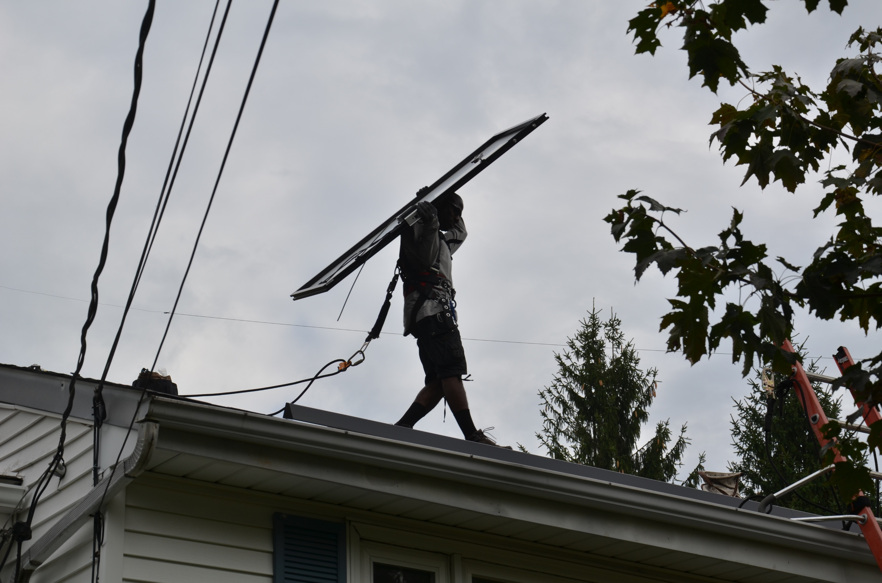
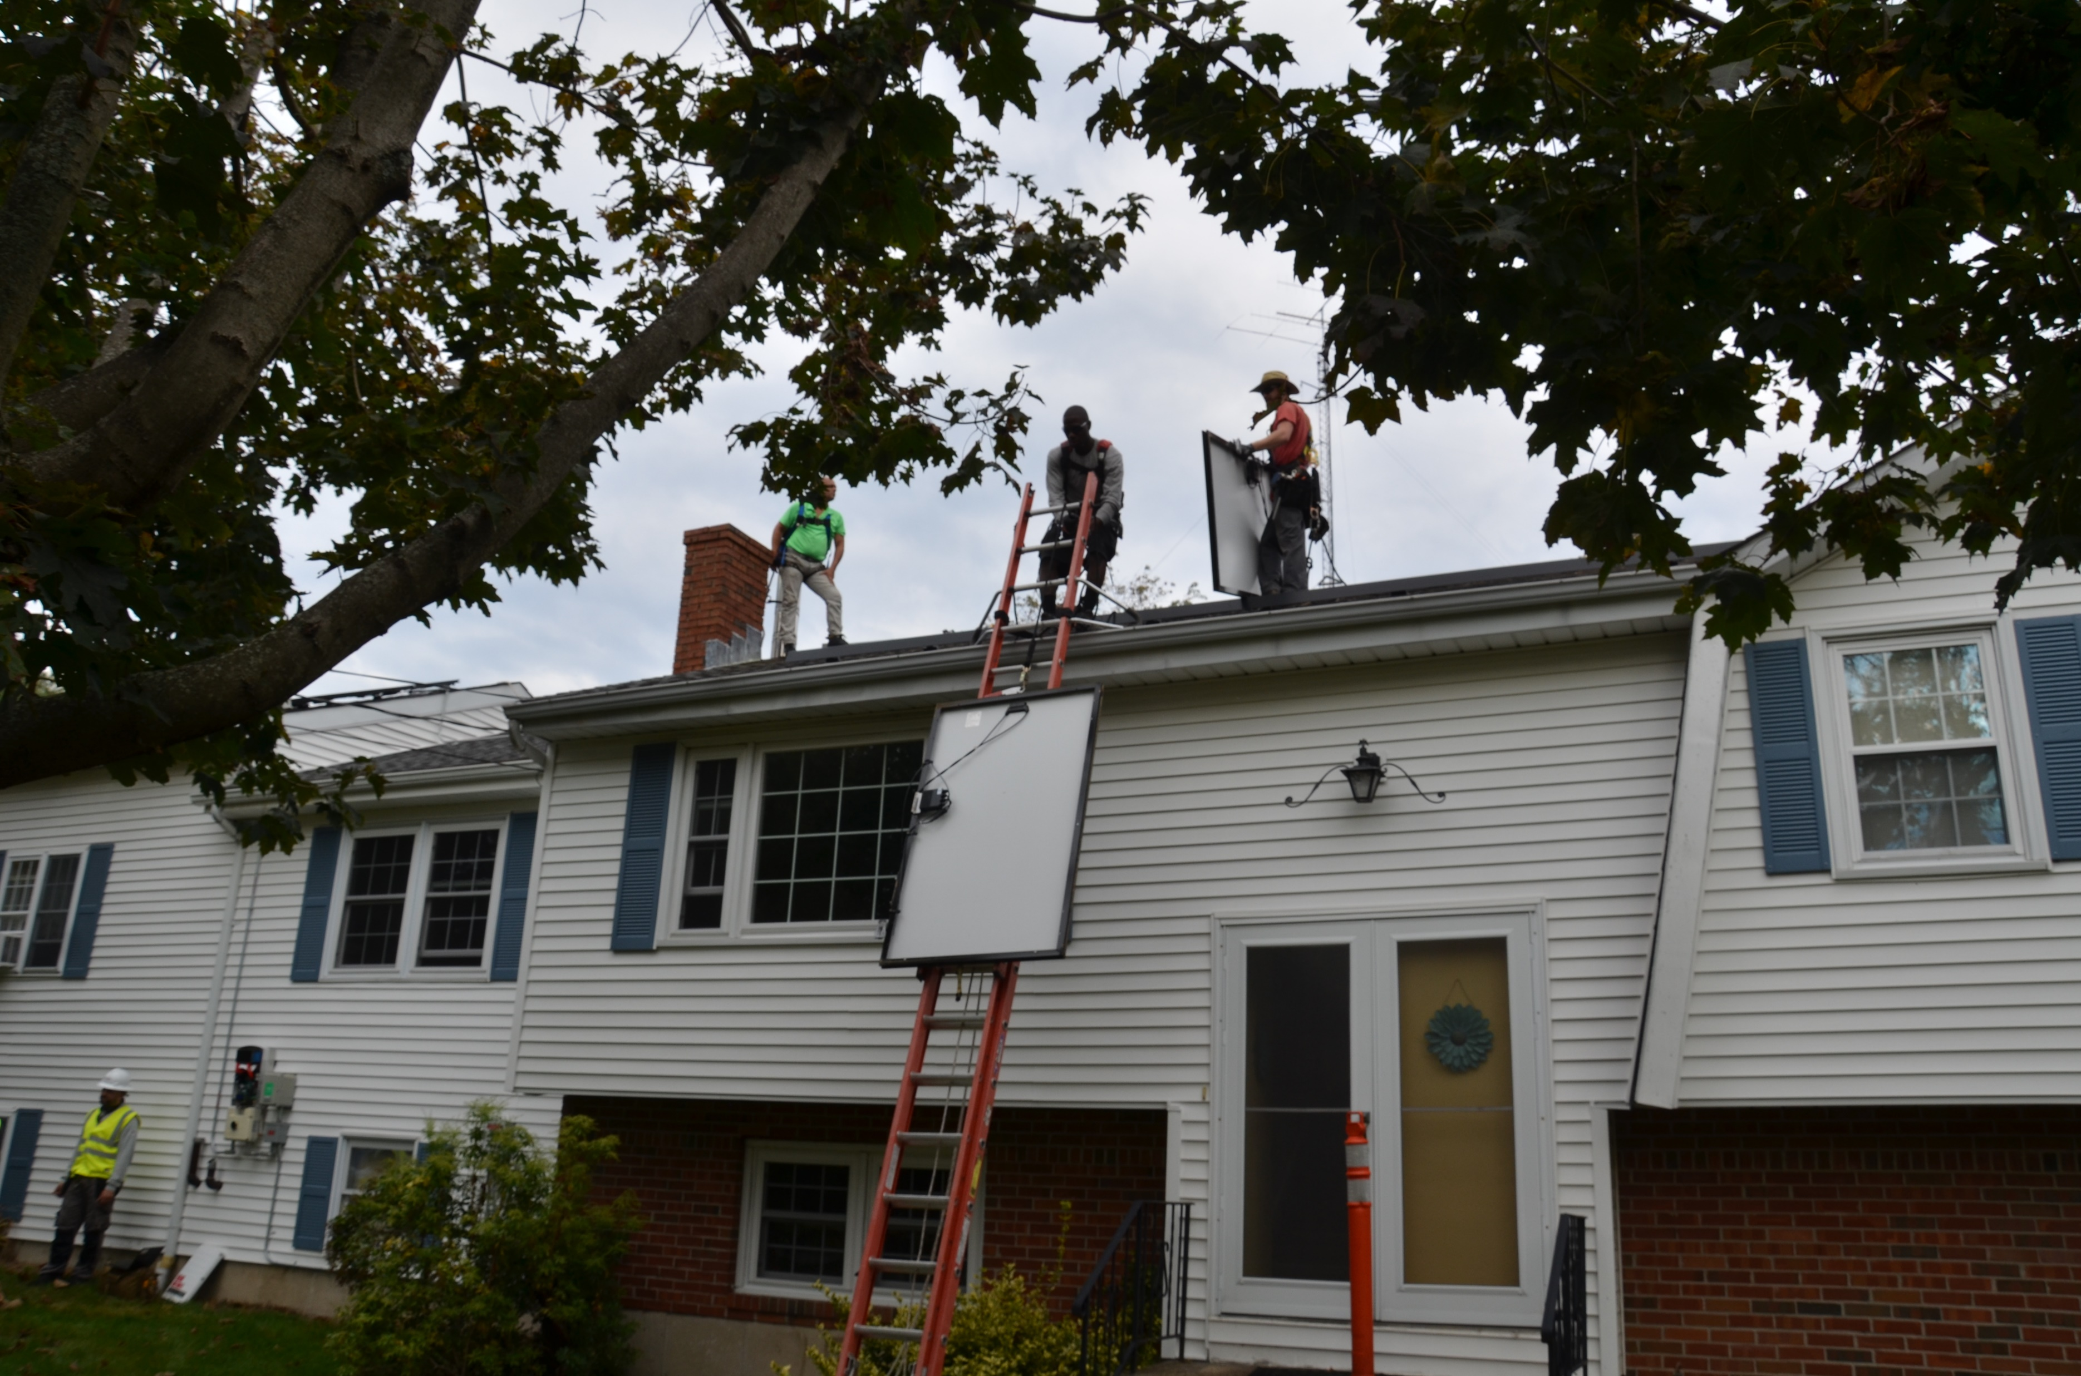
SolarEdge retrofit @ W1VLF Solar Array
Photos of labor required by SolarEdge to complete the retrofit
All 27 PV panels had to be disconnected, unbolted, lower to the ground and retrofitted with new optimizers

Slide 5
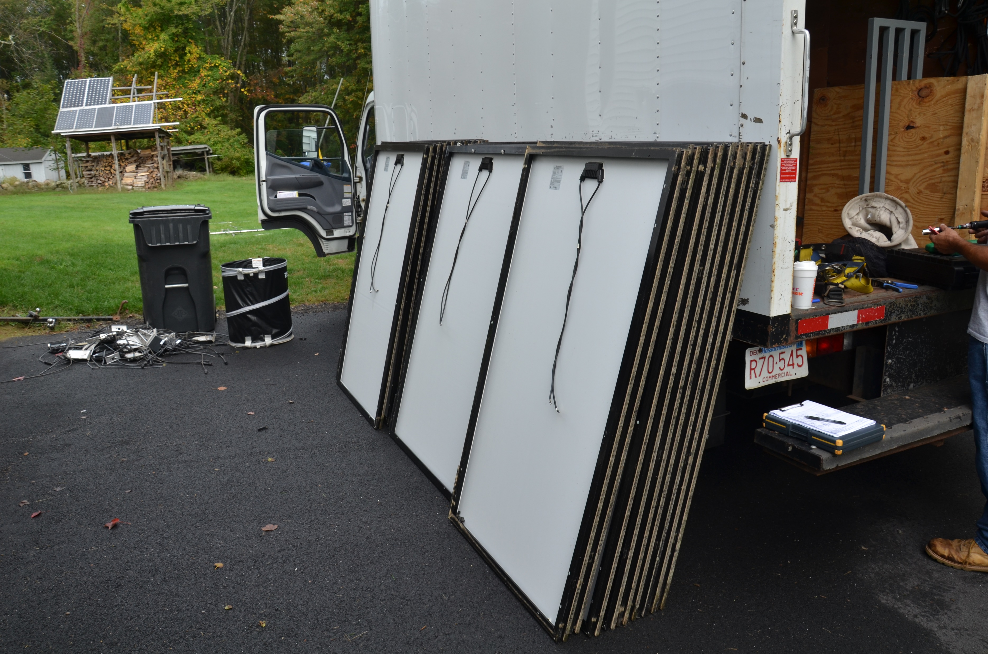
SolarEdge retrofit @ W1VLF Solar Array
All 27 PV panels on the ground.

Slide 6
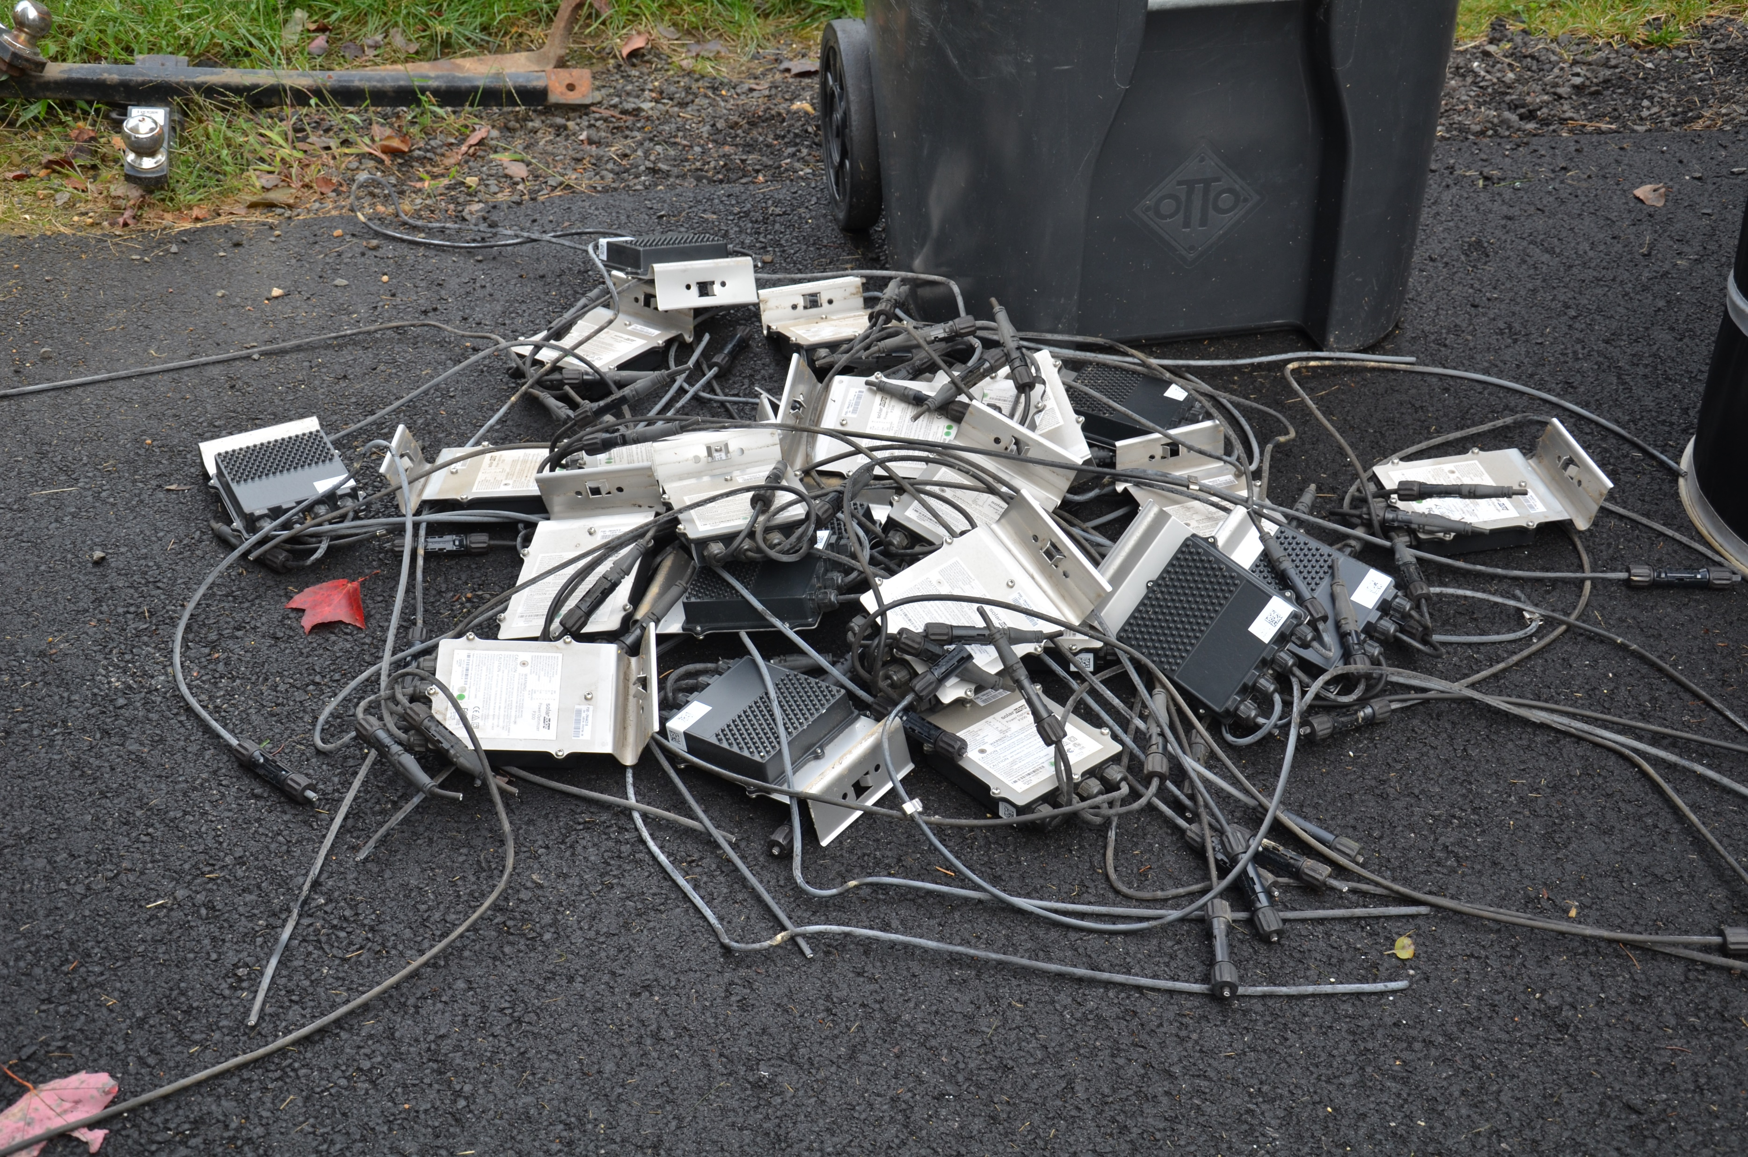
SolarEdge retrofit @ W1VLF Solar Array
Discarded SolarEdge optimizers

Slide 7
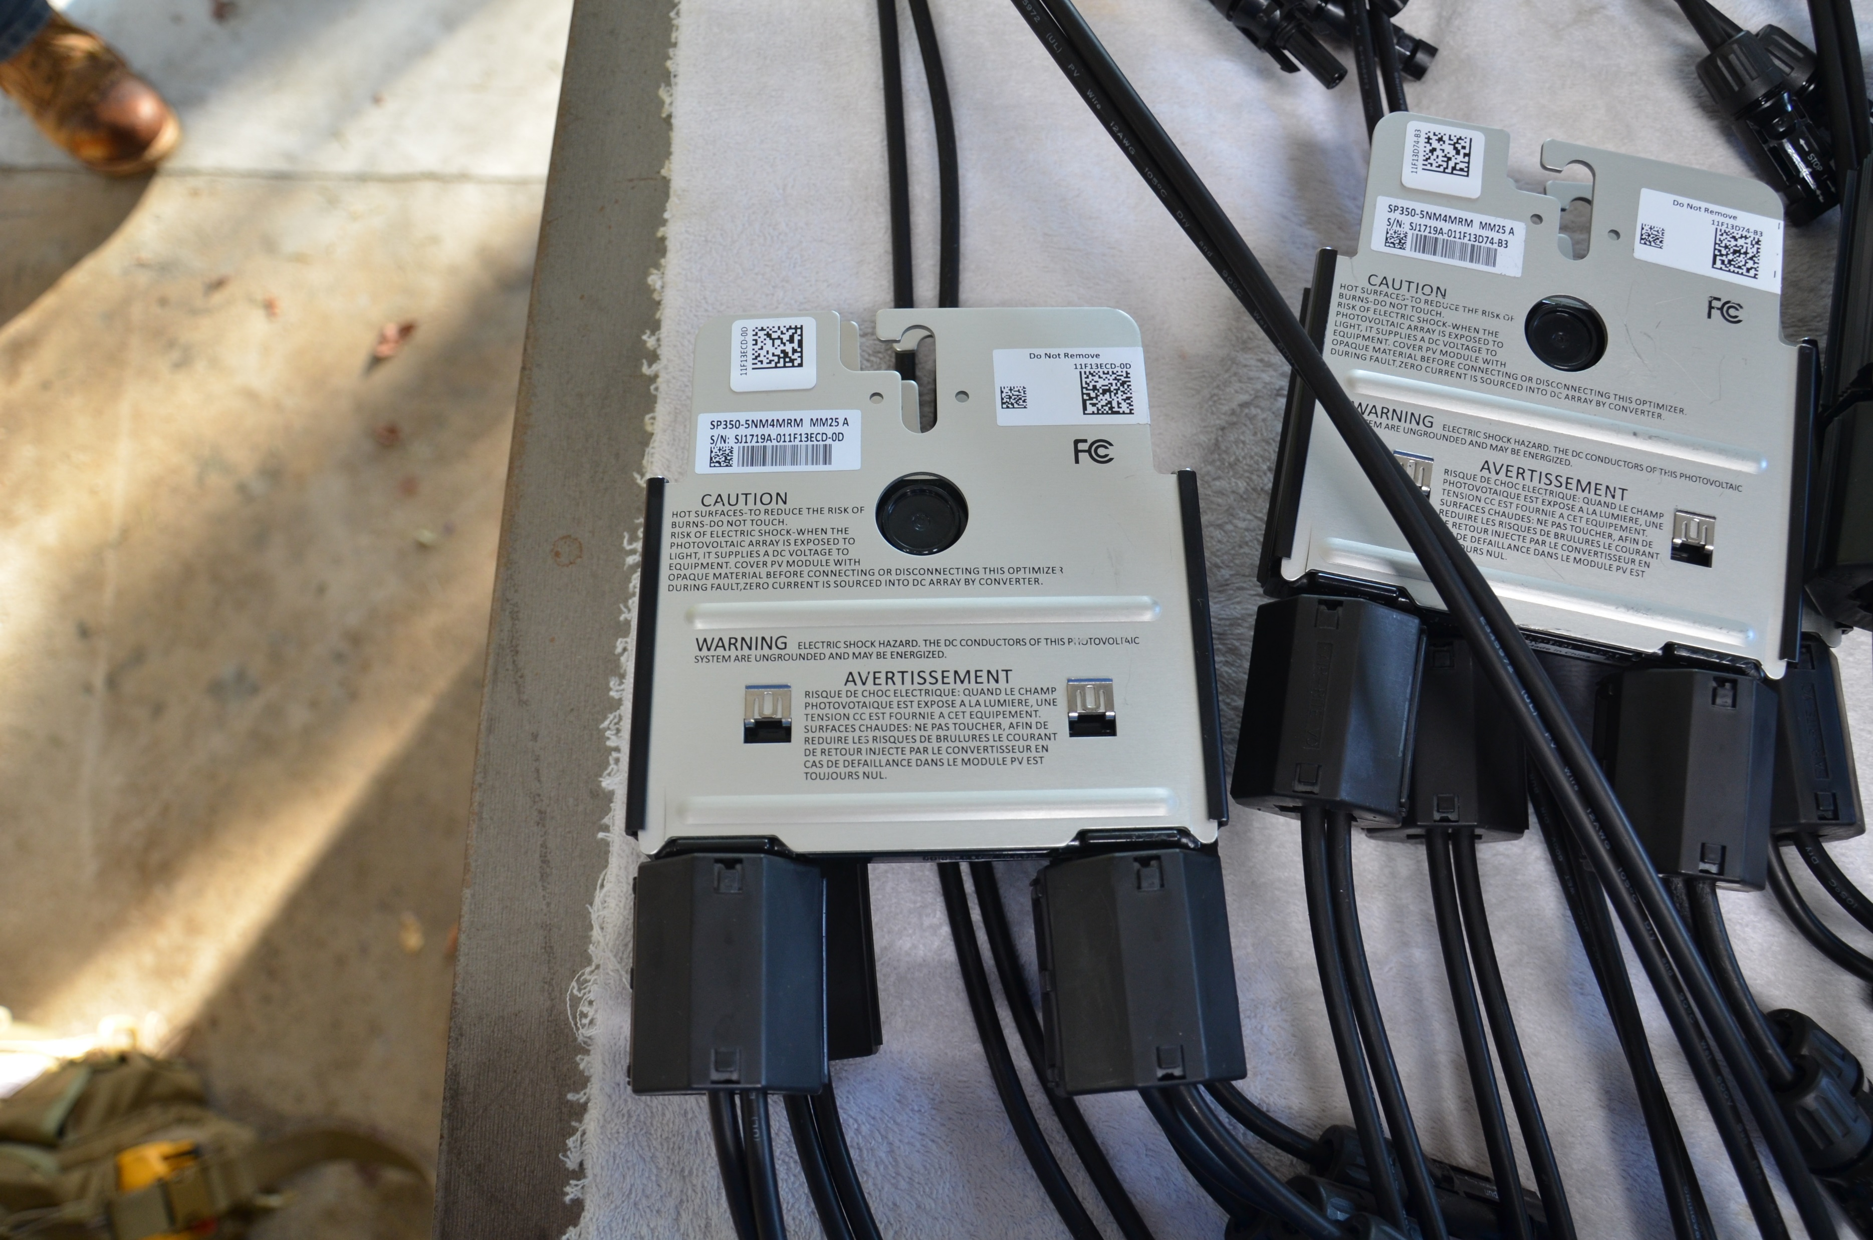
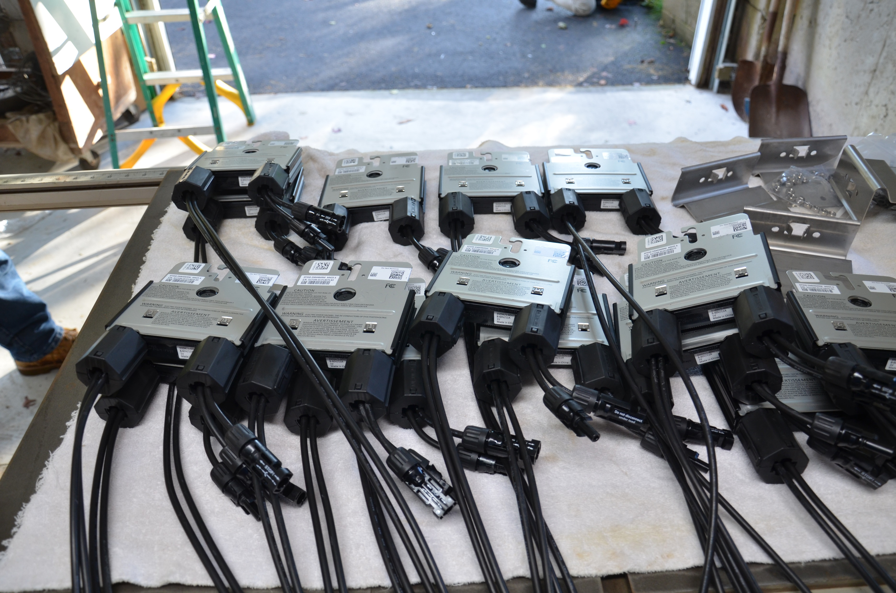
SolarEdge retrofit @ W1VLF Solar Array
New “Spread Spectrum” SolarEdge optimizers fitted with Fair-Rite Mix 31 large snap on cores. Ready for installation onto the back of the PV panels

Slide 8
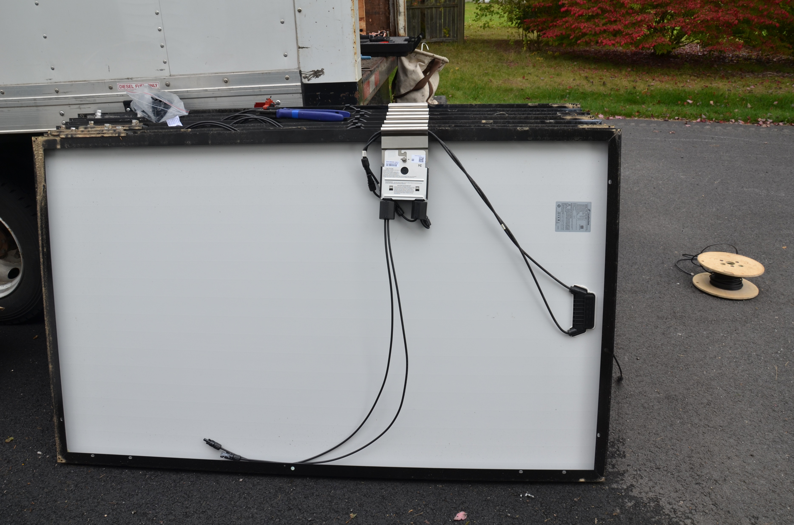
SolarEdge retrofit @ W1VLF Solar Array
New “Spread Spectrum” SolarEdge optimizers fitted with Fair-Rite Mix 31 large snap on cores. Ready to be reinstalled on the roof. Note that the wires from the PV panel are twisted and have CMC’s installed as well as the panel interconnect cables.

Slide 9
SolarEdge retrofit @ W1VLF Solar Array
Summary
A total of 4 installers were working of the retrofit of the system for a total of 7 hours. Its difficult to show the actual amount of labor expended by SolarEdge to do these retrofits in a few photographs.
Not shown is the PV panel interconnect cables being removed and replaced with new cables in a twisted pair configuration. Eliminating the loop configuration of the original installation. This required the use of several hundred feet on new interconnect cable and connectors
All workers were using safety line tied off to designated anchor points on the system.
Results are the 200 KHz noise spikes seen in the opening photo are completely eliminated. The noise haystacks every 18 KHz have also been eliminated.
Also of note is the fact that this retrofit is not exclusive to W1VLF but ongoing across the USA. 2 that come to mind are 1 amateur operator near Indianapolis IN and another in San Diego who has ad over the course of 3 years had 9 separate systems retrofitted.

